Slide 1



ZEPTO
Zepto Inventory & Sales Analysis
By: Khushi Nigam
Tools: PostgreSQL, SQL, Power BI

Slide 2

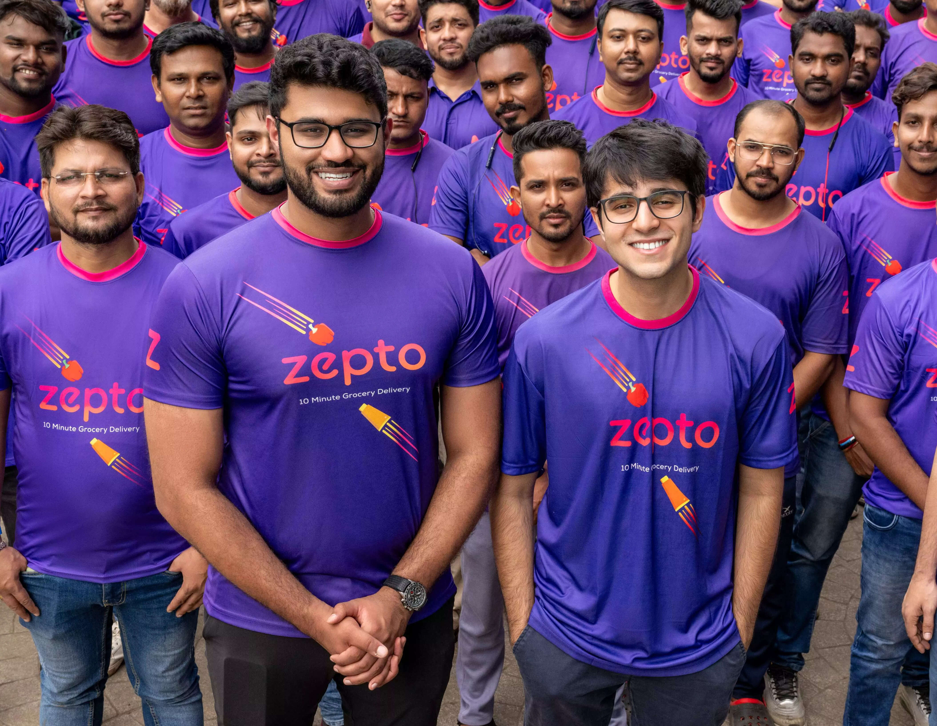
Project Objective
To analyze Zepto’s product inventory and pricing using SQL & Power BI, and generate actionable business insights related to stock availability, pricing, and revenue potential

Slide 3
Dataset Overview
Rows: 3,700+ SKUs
Source: Web-scraped from Zepto (via Kaggle)
Key Columns:
sku_id, name, category
mrp, discountpercent, discountedsellingprice
weightingms, availablequantity, outofstock, quantity
Note: Prices were originally in paise and later cleaned to ₹.

Slide 4

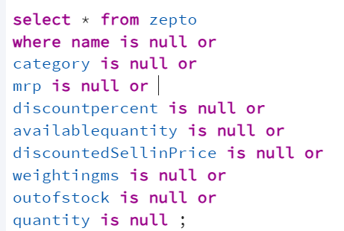
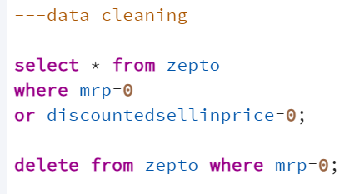
SQL Data Exploration & Cleaning
Checked for nulls & duplicate SKUs
Removed rows with MRP = 0

Slide 5
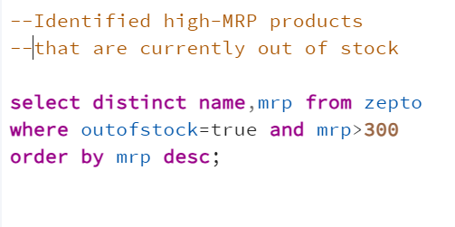
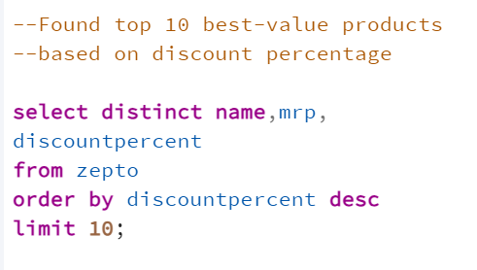
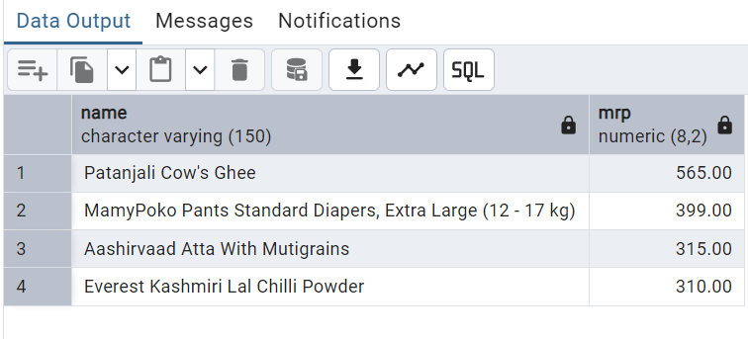
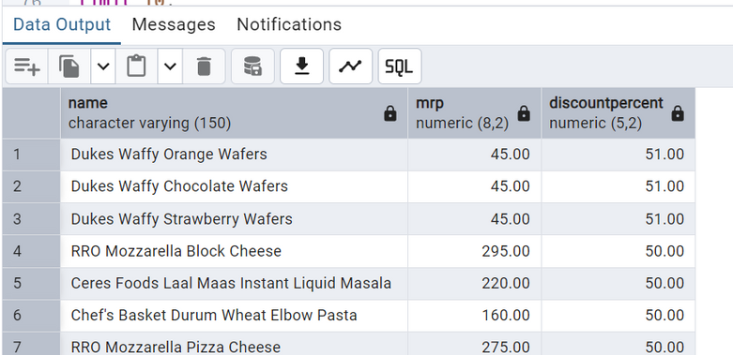
Top 10 best-discounted products
Products out of stock with high MRP

Slide 6
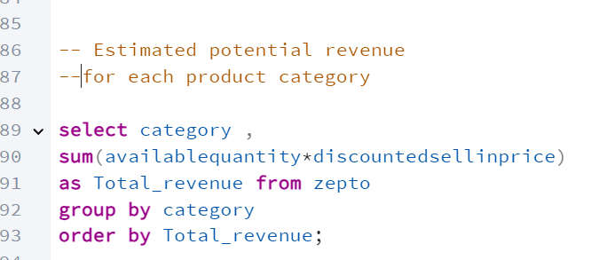
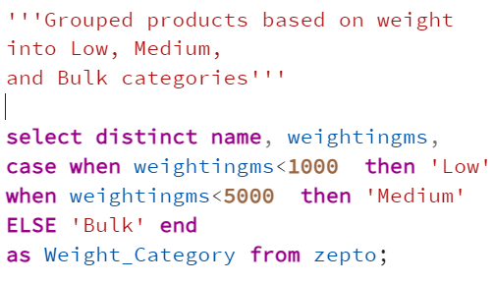
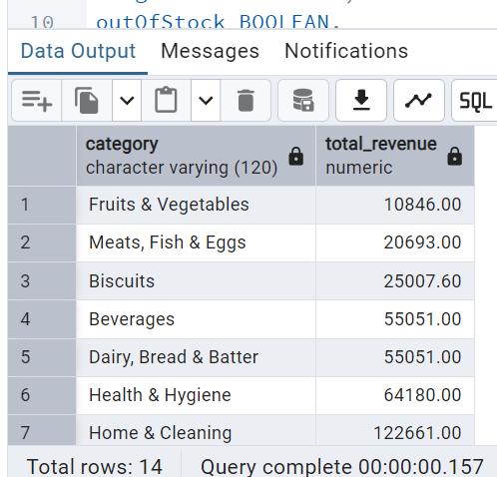
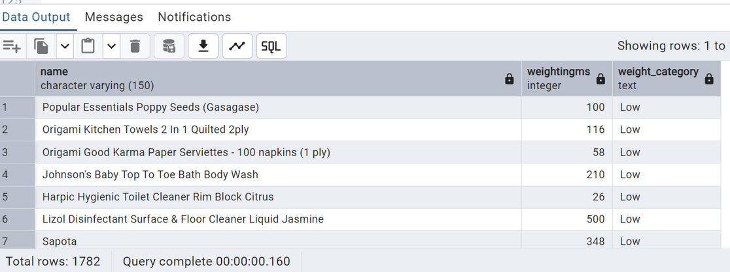
Segmentation by product weight: Low, Medium, Bulk
Revenue estimation = price × quantity available

Slide 7
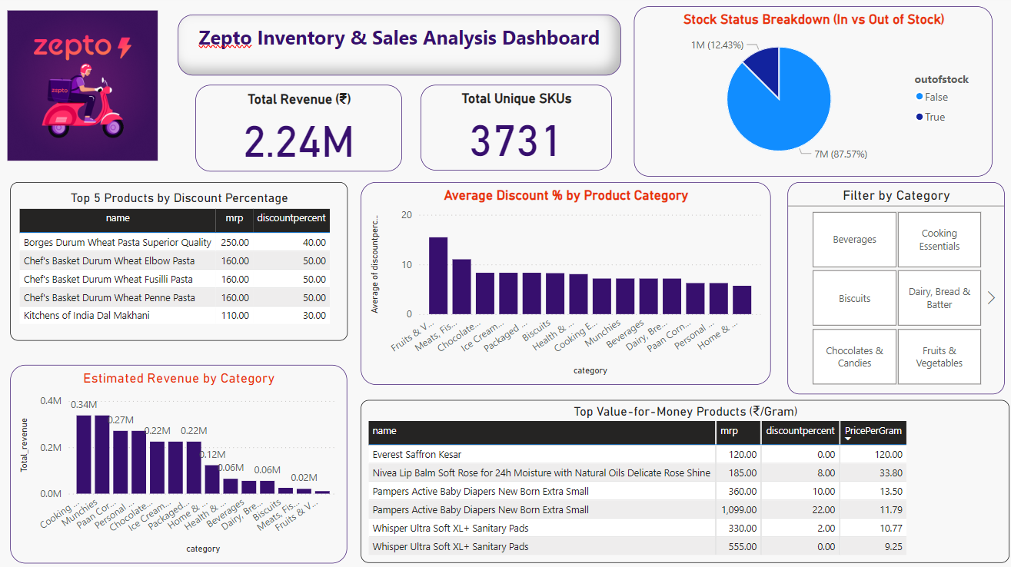
PowerBI DASHBOARD

Slide 8

87% of products are in stock
High-MRP items often out of stock
Fruits & Meats have highest discounts
Whisper, Pampers offer best value per gram
Revenue is highest from Staples & Snacks categories
Key Insights

